Slide 1

Foes: Teaching JavaScript Fundamentals through a Multiplayer fighter game
Alec burns, Alex shaklee
Alex Shaklee, Alec Burns

Slide 2
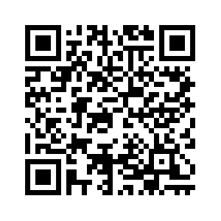
pre-survey
To access the pre-survey either copy the following link or scan the QR Code.
When asked what group this is please click ‘FOES’.
ABURNS10.ALTERVISTA.ORG OR

Slide 3

Meet the Creators of “foes”
Alec Burns
Alex Shaklee

Slide 4
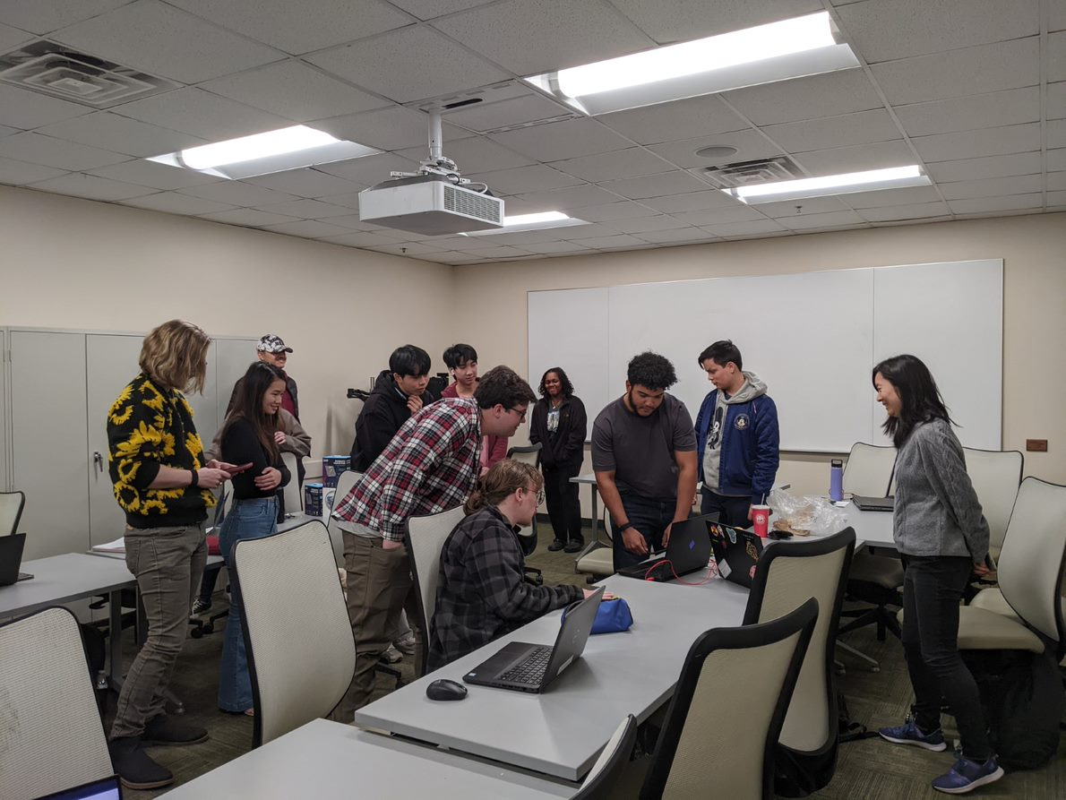
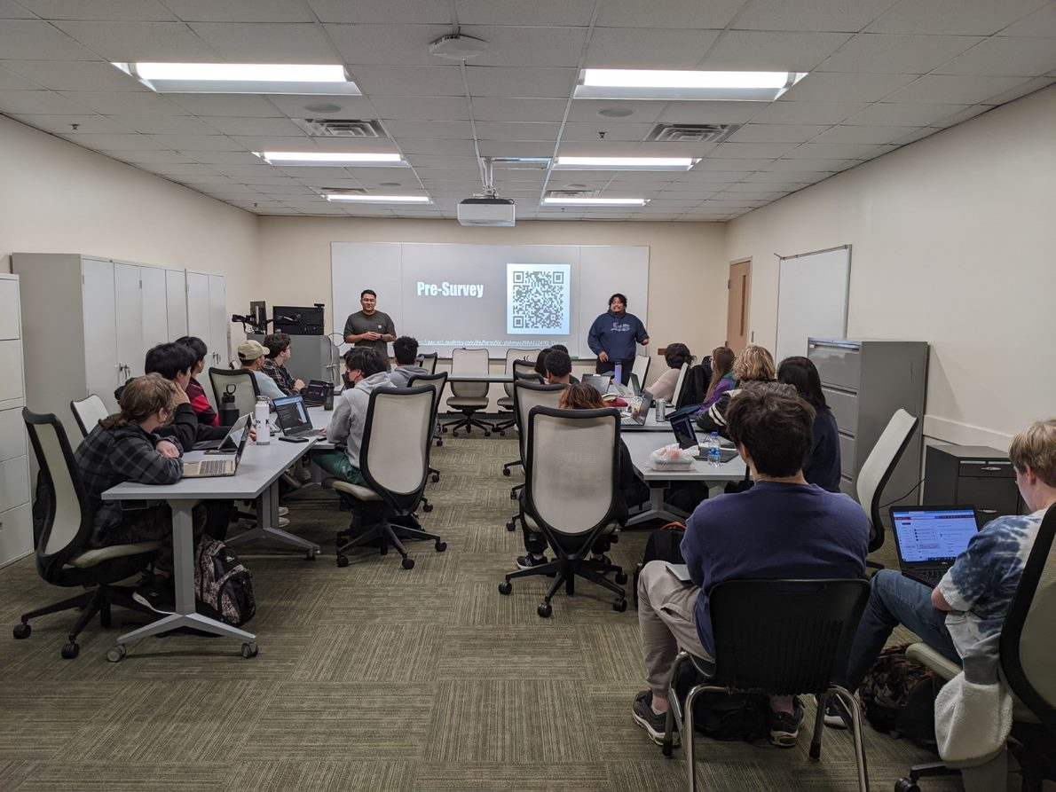
What is tap?
GGC's Technology Ambassador Program (TAP) is a program designed to give undergraduate students the opportunity to work on technical, leadership, and communication skills, all while creating projects designed for community outreach.
Team Expectations | Examples of Technology | Outreach Events
Students must participate in groups of 3-4 to gain experience with a chosen technology. Each group must then present and teach their chosen technology, both to invoke interest in their community and to achieve a deeper understanding for themselves. | Online Games (Scratch, JS) Games in Unity Hardware Controllers (Makey Makey, Arduino) AR / VR Technology and Programming 3D Printing Robotics / Drones (Sphero, Codrone) | Each team will gain the opportunity to participate in outreach-service learning events to present their projects to kids ranging from K-12 and their college peers. Example events: - Super Saturday Series - Atlanta Science Festival
STEC - 4800

Slide 5
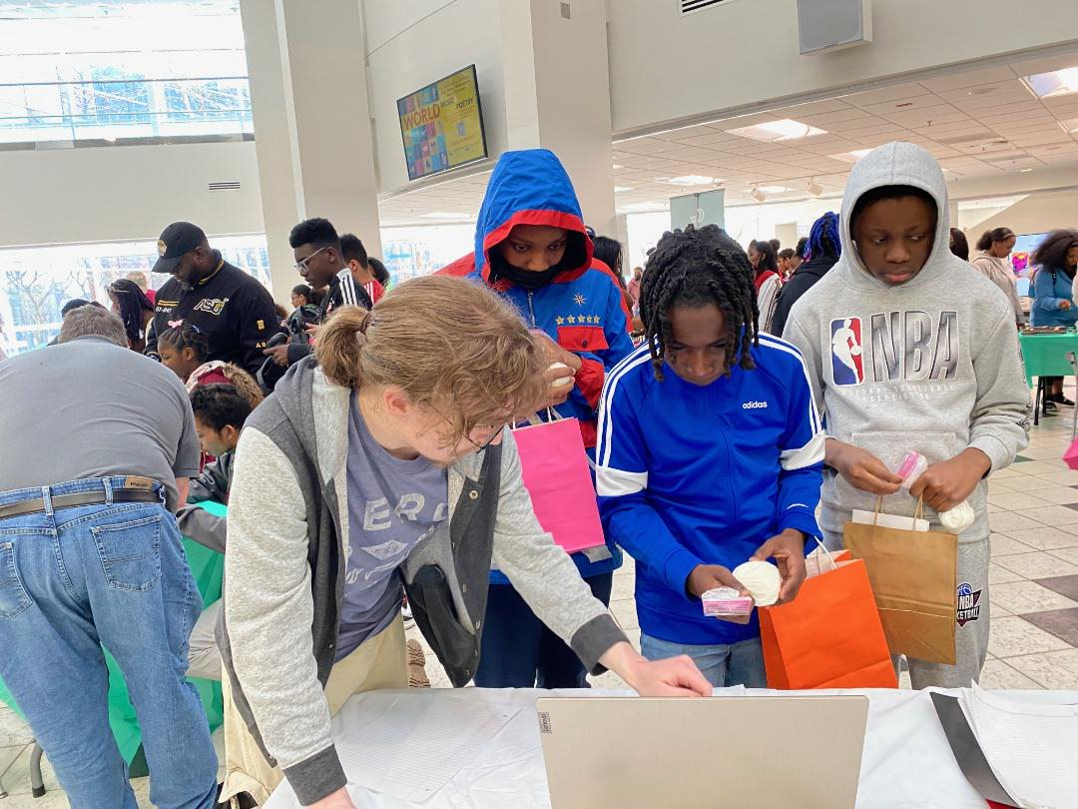
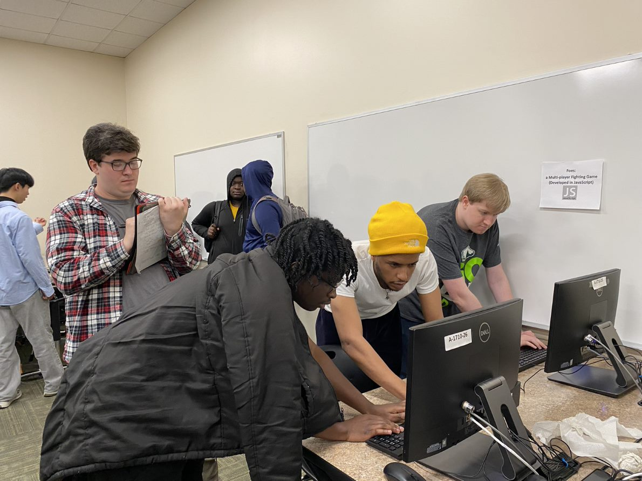
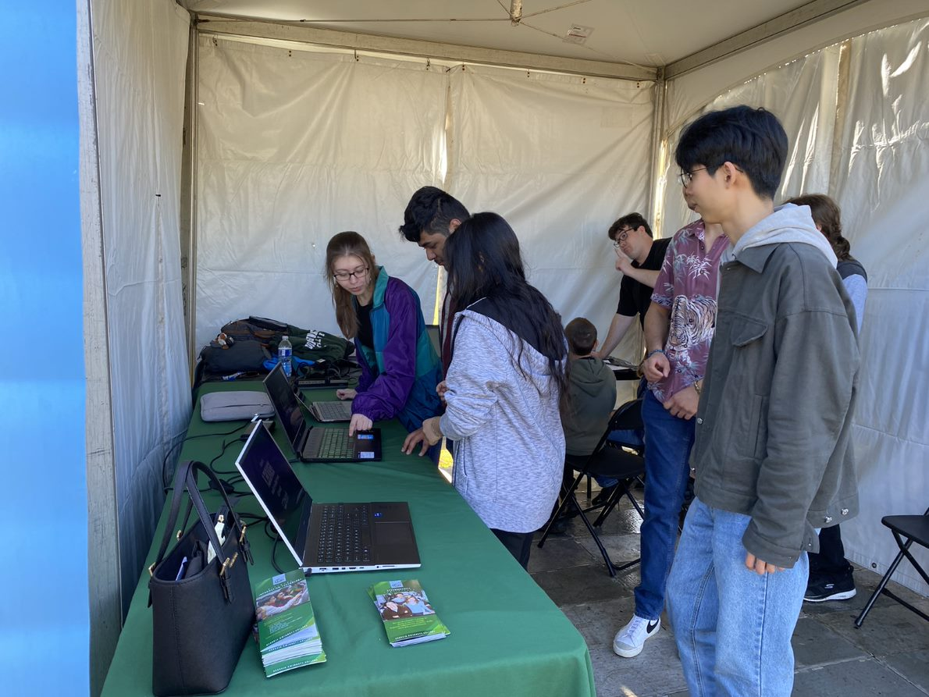
Event Examples:
Atlanta Science Festival
At GGC
GGC's TAP Expo
Atlanta Science Festival At Piedmont Park

Slide 6

What is foes? To Play
riendly, two player game
ppose your opponent
arn powerups to get stronger.
hoot the opponent to win the game
F
Simply grab a partner and use the following link:
aburns10.altervista.org
O
E
S

Slide 7
Rules FOR ‘FOES’
Each Player will start with:
3 health ‘points’
A double jump
3 'shots'
Each player must shoot the other while dodging the enemy player's projectiles. Losing your health results in a Round Loss.
However, when a player loses a round, they are offered 1 of 2 randomized powerups which can be stacked. This gives the previous loser an opportunity to win in the next round.
The first player to win 5 rounds wins the game.
PLAYER 1 CONTROLS | PLAYER 2 CONTROLS
W: Jump A: Left D: Right V: Shoot | Up Arrow Key: Jump Left Arrow Key: Left Right Arrow Key: Right Forward Slash(/): Shoot

Slide 8
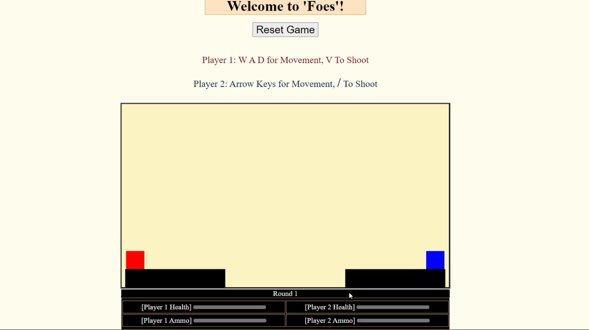
Here is an example of how FOES is played!

Slide 9
Workshop 1: Introduction Page
In this exercise, we will learn how to edit and create dynamic webpages. This exercise aims to teach students the basics of formatting with HTML and CSS, along with how the utilization of JavaScript allows us to create interactive games much like ‘FOES’.

Slide 10
Workshop 1: What is a webpage?
Web Pages are simply hypertext files hosted on the internet. Most, if not all Web Pages are formed using the following programming languages:
HyperText Markup Language Version 5 (HTML5)
Cascading Style Sheets (CSS)
JavaScript (Not Related to Java)
PHP (Hypertext Preprocessor)
The following workshop will only focus on these 3 languages

Slide 11
Workshop 1: What Can each language do?
HTML – Creates boxes on the Web Page and then stores text inside of them. These boxes are called 'Tags’
<h1> Hello! </h1> Creates a “top-level” header. This header will be large and is often used for titles.
CSS - Takes elements from HTML and changes how they look.
background-color: pink; Will change the background color of a webpage from white to orange
JavaScript/PHP - Can perform both Frontend (Client Side) and Backend (Server Side); Change web elements in ways beyond the scope of HTML and CSS. They don’t need to be used for a webpage to be functional but can be extremely useful.
*In this workshop we will not use PHP as it goes beyond the scope of this project, however it is good to know the capabilities of PHP.

Slide 12
Workshop 1: Access Workshop Materials
There are two ways to access the following workshop. This PowerPoint will highlight how to do the Workshops while using CodePen.
To access Workshop 1, please click the following link: Starter 1: JavaScript and Elements (codepen.io)
NOTE: It is important that as you go through this Workshop that you do not hit the refresh button or manually refresh the page as it will cause all your changes to be lost.

Slide 13
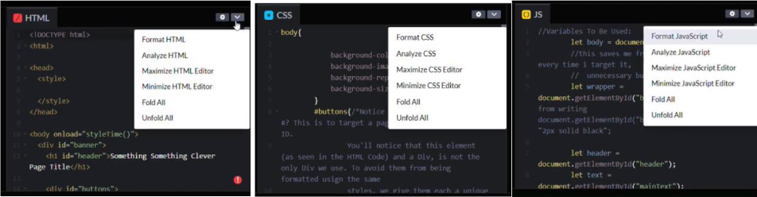
Step 1 – Format the page
Before starting to code with CodePen take this time to format your pages and read the code.
To Format:
For the HTML Mini-screen in the upper right corner next to the gear button, click the arrow and a dropdown should appear. Click the first option that states “Format HTML”. Do the same thing for the other mini-screens. Doing this ensures that your code will be readable and line up with the code in the powerpoint.

Slide 14
Step 1 (part 2) – Coding pages
These three screens represent the different coding languages that we talked about previously.
HTML CSS JavaScript

Slide 15
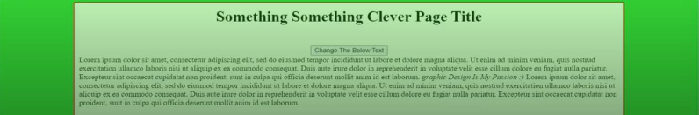
step 1 (part 3) – Webpage Updates
All the changes we make from now on will show up on the bottom half of our screen. Changes will happen almost instantly because CodePen will refresh the page for us to get the most recent changes.

Slide 16
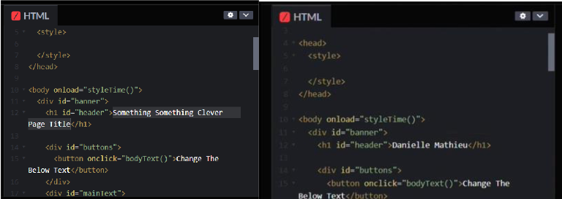
step 2 – Change Webpage title
In the HTML screen find <h1 id=“header”>”Something Something Clever Page Title”</h1>. Highlight it and replace the words “Something…” with your name.
Wait a bit and see CodePen update your webpage with your change!

Slide 17
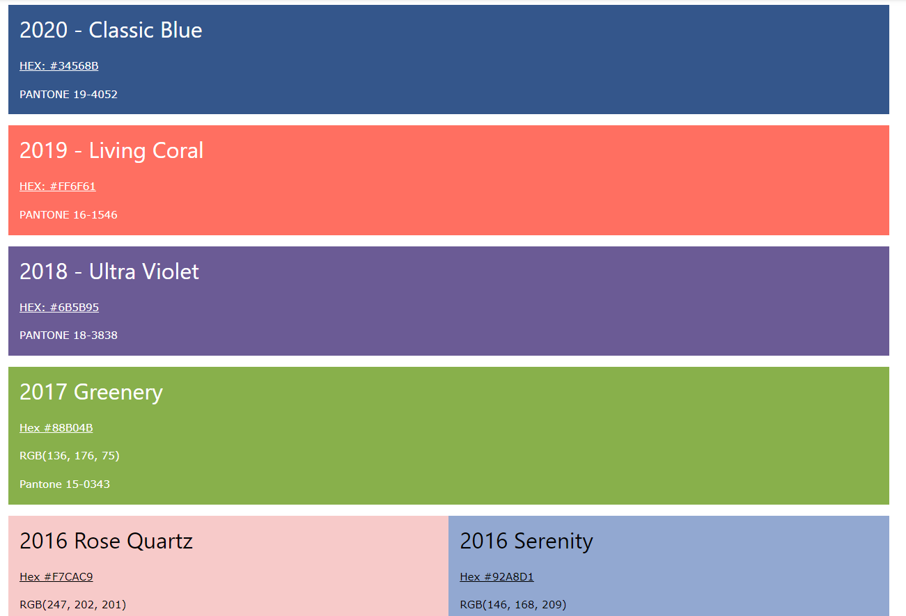
Step 3 - Change The Background Color
To change your webpage background, go the CSS coding screen and find the words “background-color: “
Replace the limegreen color with one of these or enter a color of your own!
TIP: If you are using your own color, be sure to stick to safe colors such as blue, green, purple….

Slide 18

Step 4 - buttons
A button is something that the user can click on, and when they click on it a certain action happens.
What happens when we click this button on our webpage?

Slide 19
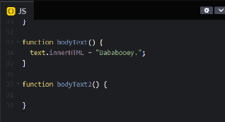
Step 4 (Part 2) – Make a function
To make our button we need to create a function in the JS (JavaScript) mini-screen under the first bodyText function.
Let’s call it function bodyText2(){}.

Slide 20
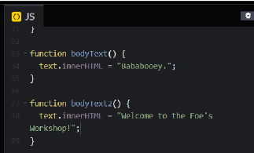
Step 4 (Part 3) – Make a message
In your function type:
text.innerHTML = “”;
And in the quotations place your own text inside to make your own custom message. For example, “Welcome to the Foe’s Workshop!”

Slide 21
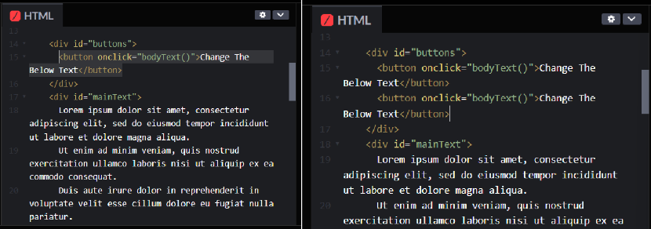
Step 4 (Part 4) – Make a button
Next go to the HTML Screen and copy the <button onclick=“bodyText()”>Change The Below Text</button>, so that way we can view our new button on our webpage.

Slide 22
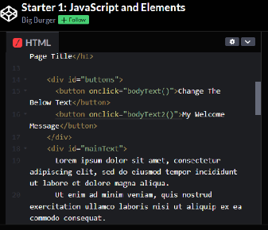
Step 4 (Part 5) – Make a button name
Change the name of your onclick method to bodyText2() and change the name of your button from “Change The Below Text” to “My Welcome Message” for example.

Slide 23
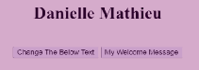
Step 4 (part 6) – click your button
Now click on your new button.

Slide 24
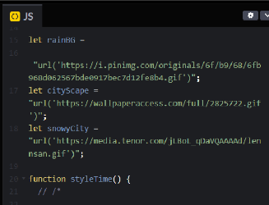
Step 5 – add background image
Let’s add a dynamic background image to our webpage so that way it’s not just a plain color!
To do so go to the JavaScript (JS) mini-screen and find the three variables: rainBG, cityScape, snowyCity

Slide 25
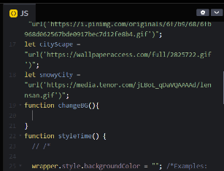
Step 5 (Part 2) – create background function
Under the last variable snowyCity let’s create a function called changeBG.

Slide 26
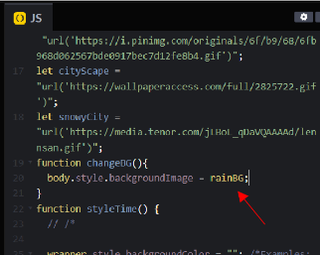
Step 5 (Part 3) – add background image
Let’s add the body.style.backgroundImage = rainBG;
You don’t have to use rainBG. You can use snowyCity or cityscape.

Slide 27
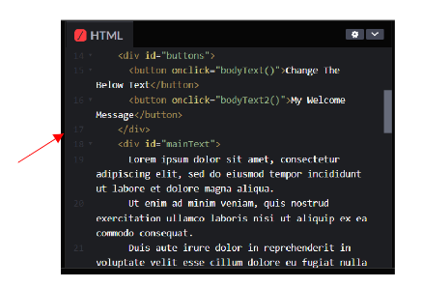
Step 5 (part 4) – add background image button
Let’s add a button under our bodyText2 function in our HTML mini-screen.

Slide 28
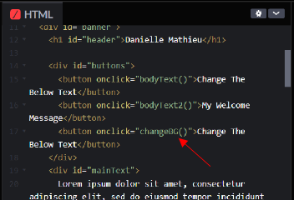
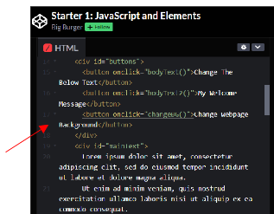
Step 5 (part 5) – add background image button
Change the onclick method to be the changeBG function we just created and change the name of the function to Change Webpage Background

Slide 29
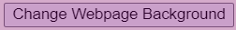
Step 5 (part 6) – Click your Button
Now click on your new button.

Slide 30


Step 6 - Change frog picture
Let’s change our frog picture to something else. In your web browser search for anything such as cats, crayons, computers and find a picture you like. Here I am searching for “Dingus the cat”.

Slide 31
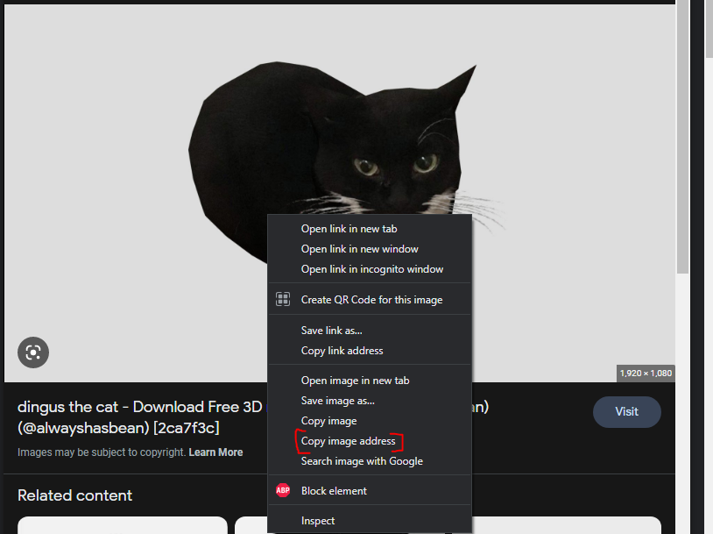
Step 6 (part 2) – Copy image address/link
Right click on the picture you chose and copy the image address/link!

Slide 32
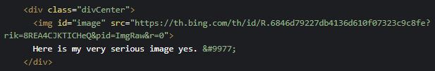
Step 6 (part 3) – Copy image address/link
Go back to CodePen and in your HTML mini-screen search for the block of code that starts with <div class=“divCenter”>. The code underneath this section is what allows us to see the image of the frog!
To make our webpage hold our picture we must replace the current src=“” link with our own.

Slide 33
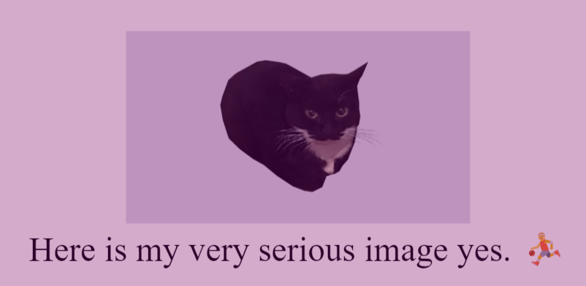
Step 6 (part 4) – Your new image
Your page should now have a new picture displayed in the middle!

Slide 34
End of workshop 1
You have now finished Workshop 1 using CodePen!
Try experimenting with your new webpage by adding new buttons, changing the values of the button, or changing the text/pictures!

Slide 35
Workshop 2: introduction/Access Workshop Materials
In this exercise, we will learn how to animate objects in JavaScript using the canvas
Please do not click the link at the bottom of the page as it may cause CodePen change the way the development page looks. Instead, to access Workshop 2, please click the following link: Starter 2: Animation (codepen.io).
NOTE: It is important that as you go through this Workshop that you do not hit the refresh button or manually refresh the page as it will cause all your changes to be lost.

Slide 36
Step 1 – format the page
Before starting to code with CodePen take this time to format your pages and read the code.
To Format:
For the HTML Mini-screen in the upper right corner next to the gear button, click the arrow and a dropdown should appear. Click the first option that states “Format HTML”. Do the same thing for the other mini-screens. Doing this ensures that your code will be readable and line up with the code in the powerpoint.

Slide 37
Step 1 (part 2) – Coding pages
These three screens represent the different coding languages that we used in Workshop 1.
HTML CSS JavaScript

Slide 38
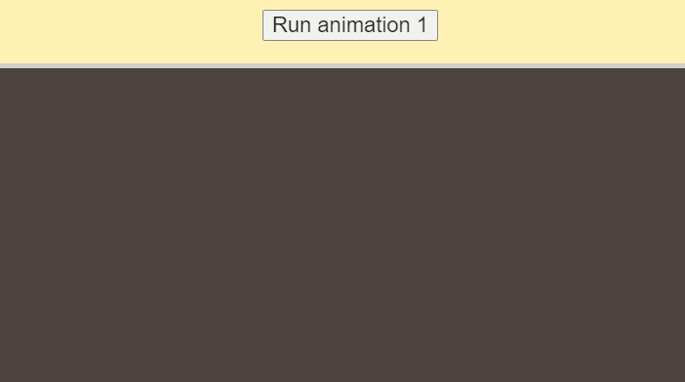
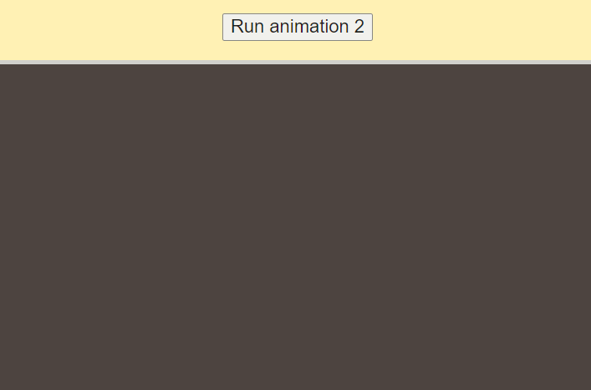
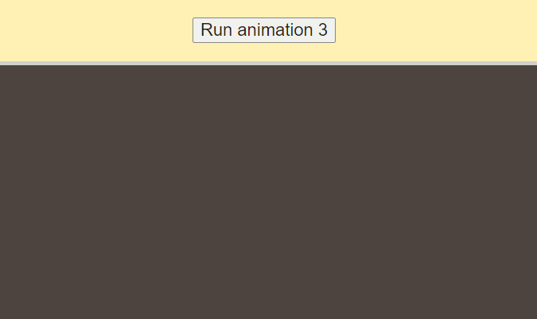
Step 2 – get familiar with your code
For this Workshop, our code will run in canvases. Canvases are the boxes that will show up under the buttons to start the animations. Each animation that we will work on will run in their own box/canvas.
Before starting click the buttons to see what each canvas does!

Slide 39
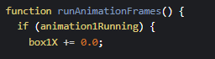
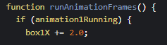
step 3 – Add animation to canvas 1
When we click on “Run animation 1”, our box does not move. To change that in the JS mini-screen in the function runAnimationFrames(){} lets change box1X += 0.0 to 2.0.
The 2.0 represent the number of pixels we want the box to move right per interval.

Slide 40

step 3 (part 2) – run animation for canvas 1
Now what happened to our animation?

Slide 41
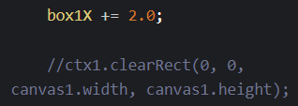
step 3 (part 3) – Fix animation for canvas 1
You will notice that the canvas still has a red box drawn on areas where our box was previously. This is because we haven't cleared out the canvas before drawing our box in a new position
We will now uncomment the line below our box1X += 2.0 to clear our canvas before a new box is drawn.

Slide 42
step 3 (part 4) – run animation Again for canvas 1
Click the button “Run animation 1” again. Now what happened to our animation?

Slide 43
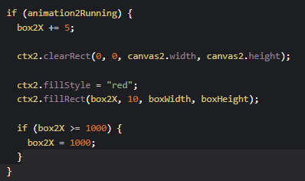
step 4 – Fix animation 2
In animation 2, when we click the “Run animation 2”, we should have the same result as animation 1.
This time, we want to prevent the box from moving off of the screen, so we are going to use if statements
We want to change 1000 to canvas2.width

Slide 44

step 4 (part 2) – What happened to animation 2?
Click the button “Run animation 2” again. Now what happened to our animation?

Slide 45
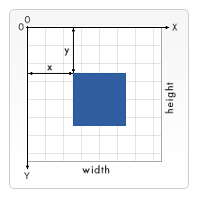
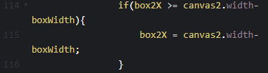
step 4 (part 3) – Subtract Box width
Despite adding the if statement, our box has still traveled outside of the canvas.
This is because when we draw the box at an X coordinate, JavaScript will draw the box to the right of the coordinate.
With this in mind, we need to set the value of X to the end of the canvas minus the box's width.

Slide 46
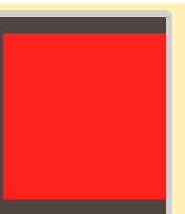
step 4 (part 4) – run animation 2 again
Click the button “Run animation 2” again. Now what happened to our animation?

Slide 47

step 5 – Run animation 3
Click the button “Run animation 3”.
Now what happens in this animation?

Slide 48
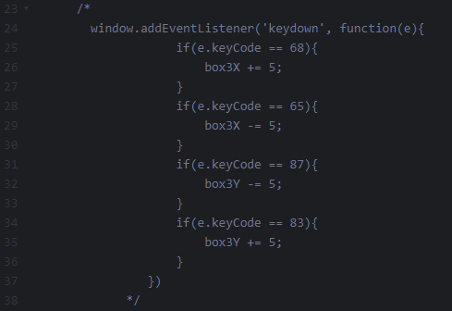


Step 5 (part 2) – run animation 3
Nothing happens because, in animation 3, we will make our box move once it receives an input from the user.
Uncomment this section of our code by getting rid of /* and */, and you should be able to now move the box using keys ‘W’, ‘A’ ‘D’, and ‘S’ (case-insensitive).

Slide 49
step 5 (part 3) – Run animation 3 again
Click the button “Run animation 3” again.
Now what happens in this animation?

Slide 50
Step 5 (part 4) – how animation 3 works
How does this code allow user input?
- First, we place an event listener to trigger whenever a key on the keyboard is pressed
- Next, we add an if statement so moving the box can only be done if the key held down is A or D
Each key on the keyboard has a number id attached to them. For example, A is 65 and D is 68. If you want to find out every number id for each key, go to this site: http://gcctech.org/csc/javascript/javascript_keycodes.htm

Slide 51
End of workshop 2
You have now finished Workshop 2 using CodePen!
Try experimenting with your new webpage by changing the addition or subtraction value of each key or try adding your own key codes!

Slide 52


Q/A?

Slide 53

Thank You
Credits:
Alec Burns (coding developer, web designer)
Alex Shaklee (coding developer, web designer)

